Slide 1
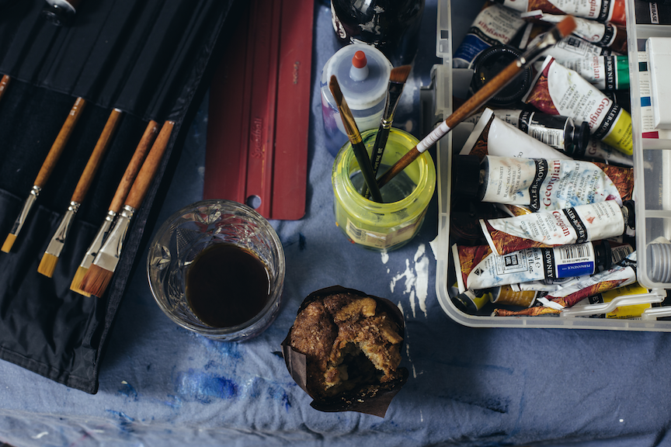
7 Qualities of a
Great Scrum Master
Notes:
"7 Qualities of a Great Scrum Master" is a look through the eyes of an experienced Scrum Master, Coach, and Change Artist at the key ingredients that make up a successful Scrum Master. These seven qualities have been distilled from many years of experience leading Agile transformations first as an internal change artist and now as an external consultant in Fortune 100 companies. Finally, much of the acquired learning that is shared within this presentation can be traced back to the work of various industry leaders, a few of whom are quoted or referenced herein for credit and further study.

Slide 2
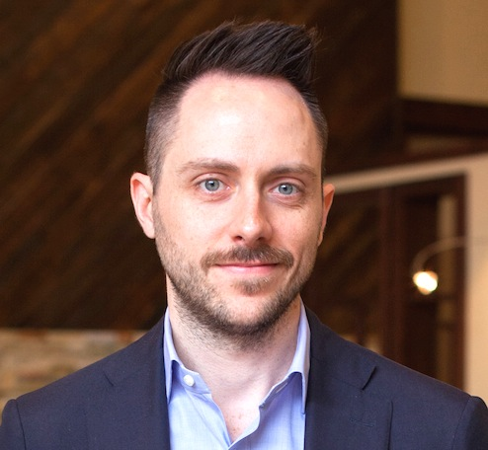

Josh Fruit
Senior Agile Consultant
SolutionsIQ, Inc. jfruit@solutionsiq.com
Engagement Lead for Fortune 100 account
7 years leading Agile change and transformations at team, program and organizational levels
6 years in IT Management
Passionate about building high performing teams and workplaces where everyone can thrive
Interests include leadership, change management
www.solutionsiq.com
twitter.com/joshfruit
linkedin.com/in/joshfruit
about.me/joshfruit

Slide 3

My Goal
Inspire you with a vision of the Scrum Master role that is greater than you might have previously considered and that moves you to go deeper in your personal journey

Slide 4

“
A persons life is an accumulation of time - just one hour is
equivalent to a person’s life. Employee’s provide their precious
hours of life to the company, so we have to use it effectively.
Otherwise, we are wasting their lives.
Eiji Toyoda

Slide 5

Vision
Notes:
Vision
Where do you want to be a year from now as a ScrumMaster?
Forget SMART goals that are often so uninspiring. What is your Big, Hairy, Audacious Goal? (Austin Powers “that’s my bag, baby”)
What if it was to work yourself out of a job?
To help my team reach such a high-performing state that I am no longer needed and can move to help another team or multiple teams as a coach.
Nanny McPhee quote

Slide 6
Ascend the mountain every 6 to 12 months to reflect
Where do you want to be a year from now as a Scrum Master?
Vision
Notes:
Vision
Where do you want to be a year from now as a ScrumMaster?
Forget SMART goals that are often so uninspiring. What is your Big, Hairy, Audacious Goal? (Austin Powers “that’s my bag, baby”)
What if it was to work yourself out of a job?
To help my team reach such a high-performing state that I am no longer needed and can move to help another team or multiple teams as a coach.
Nanny McPhee quote

Slide 7
Forget SMART goals that can lack inspiration.
What is your Big, Hairy, Audacious Goal?
“It’s my BHAG, baby! Yeah!” ~Austin Powers
Ascend the mountain every 6 to 12 months to reflect
Where do you want to be a year from now as a Scrum Master?
Vision
Notes:
Vision
Where do you want to be a year from now as a ScrumMaster?
Forget SMART goals that are often so uninspiring. What is your Big, Hairy, Audacious Goal? (Austin Powers “that’s my bag, baby”)
What if it was to work yourself out of a job?
To help my team reach such a high-performing state that I am no longer needed and can move to help another team or multiple teams as a coach.
Nanny McPhee quote

Slide 8
Forget SMART goals that can lack inspiration.
What is your Big, Hairy, Audacious Goal?
“It’s my BHAG, baby! Yeah!” ~Austin Powers
Ascend the mountain every 6 to 12 months to reflect
Where do you want to be a year from now as a Scrum Master?
Vision
Maybe your vision is...
To be the company expert on retrospectives
To be a sought after mentor to new Scrum Masters
To work yourself out of a job
Notes:
Vision
Where do you want to be a year from now as a ScrumMaster?
Forget SMART goals that are often so uninspiring. What is your Big, Hairy, Audacious Goal? (Austin Powers “that’s my bag, baby”)
What if it was to work yourself out of a job?
To help my team reach such a high-performing state that I am no longer needed and can move to help another team or multiple teams as a coach.
Nanny McPhee quote

Slide 9
Forget SMART goals that can lack inspiration.
What is your Big, Hairy, Audacious Goal?
“It’s my BHAG, baby! Yeah!” ~Austin Powers
Ascend the mountain every 6 to 12 months to reflect
Where do you want to be a year from now as a Scrum Master?
Vision
Maybe your vision is...
To be the company expert on retrospectives
To be a sought after mentor to new Scrum Masters
To work yourself out of a job
Write it down
Draw a picture, Elevator Pitch, Design the Box
Notes:
Vision
Where do you want to be a year from now as a ScrumMaster?
Forget SMART goals that are often so uninspiring. What is your Big, Hairy, Audacious Goal? (Austin Powers “that’s my bag, baby”)
What if it was to work yourself out of a job?
To help my team reach such a high-performing state that I am no longer needed and can move to help another team or multiple teams as a coach.
Nanny McPhee quote

Slide 10

Purpose
Notes:
Purpose
Sometimes purpose and vision are so closely intertwined it’s hard to distinguish them from another.
Where Vision is about what and where you want to go, Purpose is all about why you do what you do.
The best SMs have a strong, compelling, personal sense of purpose and also help their team identify their collective purpose that supports the larger org purpose.
Story about Citizens Corp Business Systems name helping us identify our purpose

Slide 11
Vision and Purpose can be mistaken for one another
Vision is about where you want to go
Purpose
Notes:
Purpose
Sometimes purpose and vision are so closely intertwined it’s hard to distinguish them from another.
Where Vision is about what and where you want to go, Purpose is all about why you do what you do.
The best SMs have a strong, compelling, personal sense of purpose and also help their team identify their collective purpose that supports the larger org purpose.
Story about Citizens Corp Business Systems name helping us identify our purpose

Slide 12
Vision and Purpose can be mistaken for one another
Vision is about where you want to go
Purpose is about why you do what you do
“What gets you out of bed in the morning?”
Purpose
Notes:
Purpose
Sometimes purpose and vision are so closely intertwined it’s hard to distinguish them from another.
Where Vision is about what and where you want to go, Purpose is all about why you do what you do.
The best SMs have a strong, compelling, personal sense of purpose and also help their team identify their collective purpose that supports the larger org purpose.
Story about Citizens Corp Business Systems name helping us identify our purpose

Slide 13
Vision and Purpose can be mistaken for one another
Vision is about where you want to go
Purpose is about why you do what you do
“What gets you out of bed in the morning?”
Purpose
The best Scrum Masters have a
strong, compelling sense of purpose
“Change the world of work” – Scrum Alliance
“Put a dent in the universe” – Steve Jobs
Notes:
Purpose
Sometimes purpose and vision are so closely intertwined it’s hard to distinguish them from another.
Where Vision is about what and where you want to go, Purpose is all about why you do what you do.
The best SMs have a strong, compelling, personal sense of purpose and also help their team identify their collective purpose that supports the larger org purpose.
Story about Citizens Corp Business Systems name helping us identify our purpose

Slide 14
Vision and Purpose can be mistaken for one another
Vision is about where you want to go
Purpose is about why you do what you do
“What gets you out of bed in the morning?”
Purpose
The best Scrum Masters have a
strong, compelling sense of purpose
“Change the world of work” – Scrum Alliance
“Put a dent in the universe” – Steve Jobs
They also help their team identify their collective
purpose within the organization.
Why does our team exist? Would it matter to the organization if it no longer existed?
Notes:
Purpose
Sometimes purpose and vision are so closely intertwined it’s hard to distinguish them from another.
Where Vision is about what and where you want to go, Purpose is all about why you do what you do.
The best SMs have a strong, compelling, personal sense of purpose and also help their team identify their collective purpose that supports the larger org purpose.
Story about Citizens Corp Business Systems name helping us identify our purpose

Slide 15

Servant Leader
Notes:
Servant Leader
Mindset. With an emphasis on service.
Much has been written about this, so won’t belabor the point. Suffice to say, this begins and ends with a mindset.
I am Second campaign, Tim McGraw “always stay humble and kind” song.
Can be hard to say practically what to go about doing. Easy to identify it when you see it, so we talk about examples we’ve seen (making sure there is fresh coffee available before the daily standup).
"My fellow humans, ask not what your colleagues can do for you, ask what you can do for your colleagues." -- Bob Marshall @flowchainsensei

Slide 16
“The servant-leader is servant first… It begins with the natural feeling that one wants to serve, to serve first.”
-Robert K. Greenleaf
Servant Leader
Notes:
Servant Leader
Mindset. With an emphasis on service.
Much has been written about this, so won’t belabor the point. Suffice to say, this begins and ends with a mindset.
I am Second campaign, Tim McGraw “always stay humble and kind” song.
Can be hard to say practically what to go about doing. Easy to identify it when you see it, so we talk about examples we’ve seen (making sure there is fresh coffee available before the daily standup).
"My fellow humans, ask not what your colleagues can do for you, ask what you can do for your colleagues." -- Bob Marshall @flowchainsensei

Slide 17
“The servant-leader is servant first… It begins with the natural feeling that one wants to serve, to serve first.”
-Robert K. Greenleaf
A servant-leader focuses primarily on the growth and well-being of people and the communities to which they belong
-Greenleaf Center for Servant Leadership
Servant Leader
Notes:
Servant Leader
Mindset. With an emphasis on service.
Much has been written about this, so won’t belabor the point. Suffice to say, this begins and ends with a mindset.
I am Second campaign, Tim McGraw “always stay humble and kind” song.
Can be hard to say practically what to go about doing. Easy to identify it when you see it, so we talk about examples we’ve seen (making sure there is fresh coffee available before the daily standup).
"My fellow humans, ask not what your colleagues can do for you, ask what you can do for your colleagues." -- Bob Marshall @flowchainsensei

Slide 18
“The servant-leader is servant first… It begins with the natural feeling that one wants to serve, to serve first.”
-Robert K. Greenleaf
A servant-leader focuses primarily on the growth and well-being of people and the communities to which they belong
-Greenleaf Center for Servant Leadership
Servant Leader
Not soft or weak leadership, rather ability to...
Build culture, influence through example, align people to vision, seek first to understand before being understood, hold to your principles without attacking others
-Michael Spayd, Lyssa Adkins, Agile Coaching Institute
Notes:
Servant Leader
Mindset. With an emphasis on service.
Much has been written about this, so won’t belabor the point. Suffice to say, this begins and ends with a mindset.
I am Second campaign, Tim McGraw “always stay humble and kind” song.
Can be hard to say practically what to go about doing. Easy to identify it when you see it, so we talk about examples we’ve seen (making sure there is fresh coffee available before the daily standup).
"My fellow humans, ask not what your colleagues can do for you, ask what you can do for your colleagues." -- Bob Marshall @flowchainsensei

Slide 19
“The servant-leader is servant first… It begins with the natural feeling that one wants to serve, to serve first.”
-Robert K. Greenleaf
A servant-leader focuses primarily on the growth and well-being of people and the communities to which they belong
-Greenleaf Center for Servant Leadership
Servant Leader
Not soft or weak leadership, rather ability to...
Build culture, influence through example, align people to vision, seek first to understand before being understood, hold to your principles without attacking others
-Michael Spayd, Lyssa Adkins, Agile Coaching Institute
"My fellow humans, ask not what your colleagues can do for you, ask what you can do for your colleagues."
-Bob Marshall
Notes:
Servant Leader
Mindset. With an emphasis on service.
Much has been written about this, so won’t belabor the point. Suffice to say, this begins and ends with a mindset.
I am Second campaign, Tim McGraw “always stay humble and kind” song.
Can be hard to say practically what to go about doing. Easy to identify it when you see it, so we talk about examples we’ve seen (making sure there is fresh coffee available before the daily standup).
"My fellow humans, ask not what your colleagues can do for you, ask what you can do for your colleagues." -- Bob Marshall @flowchainsensei

Slide 20

Facilitator
Notes:
Facilitator
The SM isn’t ultimately responsible for the team delivering. But they are responsible to help the team continue to improve in how they work together and deliver software.
This means much of the work the SM will do in support of that goal is facilitating teamwork. A lot of this happens in formal scrum ceremonies, but it can also happen outside of those ceremonies. For instance, conflict resolution needs don’t always crop up during a scrum ceremony.
A great facilitator knows how to identify the purpose of a gathering or need of a team in any moment, help them see and align to that purpose, and help them reach and achieve that purpose or goal. The point is to leave your personal goals out of this process.

Slide 21
It is not your team
It is a team you serve through services like facilitation
Facilitator
Notes:
Facilitator
The SM isn’t ultimately responsible for the team delivering. But they are responsible to help the team continue to improve in how they work together and deliver software.
This means much of the work the SM will do in support of that goal is facilitating teamwork. A lot of this happens in formal scrum ceremonies, but it can also happen outside of those ceremonies. For instance, conflict resolution needs don’t always crop up during a scrum ceremony.
A great facilitator knows how to identify the purpose of a gathering or need of a team in any moment, help them see and align to that purpose, and help them reach and achieve that purpose or goal. The point is to leave your personal goals out of this process.

Slide 22
“A neutral process holder who guides groups through processes that help them come to solutions
and make decisions.”
-Agile Coaching Competency Framework
It is not your team
It is a team you serve through services like facilitation
Facilitator
Notes:
Facilitator
The SM isn’t ultimately responsible for the team delivering. But they are responsible to help the team continue to improve in how they work together and deliver software.
This means much of the work the SM will do in support of that goal is facilitating teamwork. A lot of this happens in formal scrum ceremonies, but it can also happen outside of those ceremonies. For instance, conflict resolution needs don’t always crop up during a scrum ceremony.
A great facilitator knows how to identify the purpose of a gathering or need of a team in any moment, help them see and align to that purpose, and help them reach and achieve that purpose or goal. The point is to leave your personal goals out of this process.

Slide 23
“A neutral process holder who guides groups through processes that help them come to solutions
and make decisions.”
-Agile Coaching Competency Framework
It is not your team
It is a team you serve through services like facilitation
Facilitator
Helps the team identify the purpose of a gathering or need of the team in any moment
Helps the team align to that purpose and desired outcomes
Helps the team achieve their purpose and goals
Notes:
Facilitator
The SM isn’t ultimately responsible for the team delivering. But they are responsible to help the team continue to improve in how they work together and deliver software.
This means much of the work the SM will do in support of that goal is facilitating teamwork. A lot of this happens in formal scrum ceremonies, but it can also happen outside of those ceremonies. For instance, conflict resolution needs don’t always crop up during a scrum ceremony.
A great facilitator knows how to identify the purpose of a gathering or need of a team in any moment, help them see and align to that purpose, and help them reach and achieve that purpose or goal. The point is to leave your personal goals out of this process.

Slide 24
“A neutral process holder who guides groups through processes that help them come to solutions
and make decisions.”
-Agile Coaching Competency Framework
It is not your team
It is a team you serve through services like facilitation
Facilitator
Helps the team identify the purpose of a gathering or need of the team in any moment
Helps the team align to that purpose and desired outcomes
Helps the team achieve their purpose and goals
The point is to leave your personal goals out of the process.
Notes:
Facilitator
The SM isn’t ultimately responsible for the team delivering. But they are responsible to help the team continue to improve in how they work together and deliver software.
This means much of the work the SM will do in support of that goal is facilitating teamwork. A lot of this happens in formal scrum ceremonies, but it can also happen outside of those ceremonies. For instance, conflict resolution needs don’t always crop up during a scrum ceremony.
A great facilitator knows how to identify the purpose of a gathering or need of a team in any moment, help them see and align to that purpose, and help them reach and achieve that purpose or goal. The point is to leave your personal goals out of this process.

Slide 25
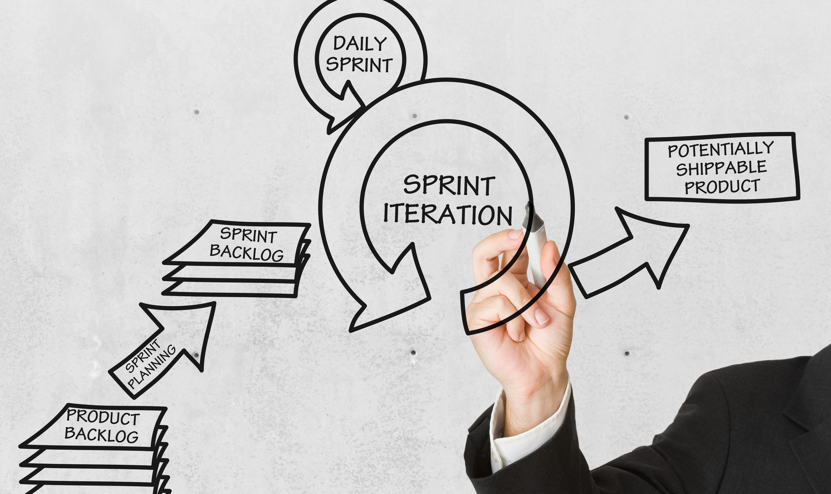
Coach
Notes:
Coach
Longer term state for a SM but a necessary skillset to start developing from the beginning.
This breaks down into three different but related coaching skillsets for an Agile Coach:
Teaching – offering the right knowledge, at right time, in right way so people absorb and use the knowledge for their best benefit
Mentoring – enabling others to learn, grow and become better professionals along their career path
Facilitating – helping others make decisions and arrive at solutions through neutral process guidance
Professional Coaching – helping people identify where they are, where they want to go, and how to get there without imparting your own desires and opinions.

Slide 26
It is not knowing and regurgitating Agile framework rules.
Despite the background photo. ☺
Coach
Notes:
Coach
Longer term state for a SM but a necessary skillset to start developing from the beginning.
This breaks down into three different but related coaching skillsets for an Agile Coach:
Teaching – offering the right knowledge, at right time, in right way so people absorb and use the knowledge for their best benefit
Mentoring – enabling others to learn, grow and become better professionals along their career path
Facilitating – helping others make decisions and arrive at solutions through neutral process guidance
Professional Coaching – helping people identify where they are, where they want to go, and how to get there without imparting your own desires and opinions.

Slide 27
It is helping individuals, teams and organizations...
Become adept at applying Agile values and principles to solve their problems and reach their highest potential.
It is not knowing and regurgitating Agile framework rules.
Despite the background photo. ☺
Coach
Notes:
Coach
Longer term state for a SM but a necessary skillset to start developing from the beginning.
This breaks down into three different but related coaching skillsets for an Agile Coach:
Teaching – offering the right knowledge, at right time, in right way so people absorb and use the knowledge for their best benefit
Mentoring – enabling others to learn, grow and become better professionals along their career path
Facilitating – helping others make decisions and arrive at solutions through neutral process guidance
Professional Coaching – helping people identify where they are, where they want to go, and how to get there without imparting your own desires and opinions.

Slide 28
It is helping individuals, teams and organizations...
Become adept at applying Agile values and principles to solve their problems and reach their highest potential.
It is not knowing and regurgitating Agile framework rules.
Despite the background photo. ☺
Coach
It is the combination of competencies such as...
Teaching, Mentoring, Facilitating, Professional Coaching
-Agile Coaching Competency Framework
Notes:
Coach
Longer term state for a SM but a necessary skillset to start developing from the beginning.
This breaks down into three different but related coaching skillsets for an Agile Coach:
Teaching – offering the right knowledge, at right time, in right way so people absorb and use the knowledge for their best benefit
Mentoring – enabling others to learn, grow and become better professionals along their career path
Facilitating – helping others make decisions and arrive at solutions through neutral process guidance
Professional Coaching – helping people identify where they are, where they want to go, and how to get there without imparting your own desires and opinions.

Slide 29
It is helping individuals, teams and organizations...
Become adept at applying Agile values and principles to solve their problems and reach their highest potential.
It is not knowing and regurgitating Agile framework rules.
Despite the background photo. ☺
Coach
“Coaching is a way of working with people that leaves them more competent and more fulfilled so that they are more able to contribute to their organizations and find meaning in what they are doing."
-James Flaherty, in "Coaching: Evoking Excellence in Others"
It is the combination of competencies such as...
Teaching, Mentoring, Facilitating, Professional Coaching
-Agile Coaching Competency Framework
Notes:
Coach
Longer term state for a SM but a necessary skillset to start developing from the beginning.
This breaks down into three different but related coaching skillsets for an Agile Coach:
Teaching – offering the right knowledge, at right time, in right way so people absorb and use the knowledge for their best benefit
Mentoring – enabling others to learn, grow and become better professionals along their career path
Facilitating – helping others make decisions and arrive at solutions through neutral process guidance
Professional Coaching – helping people identify where they are, where they want to go, and how to get there without imparting your own desires and opinions.

Slide 30

Change Artist
Notes:
Change Agent
A mindset first. Can’t become comfortable with the status quo in team or org. Status quo is safe but it is also stale, uninspiring, and prone to decay.
Be the change you wish to see – embody and live out Lean and Agile Values & Principles
And the skills to both lead and help team and org navigate change successfully.
ADKAR
Kotter
McKinsey
Lean CM

Slide 31
Be the change you wish to see.
A good start is mastering and exemplifying
Lean and Agile Values and Principles
Change Artist
Notes:
Change Agent
A mindset first. Can’t become comfortable with the status quo in team or org. Status quo is safe but it is also stale, uninspiring, and prone to decay.
Be the change you wish to see – embody and live out Lean and Agile Values & Principles
And the skills to both lead and help team and org navigate change successfully.
ADKAR
Kotter
McKinsey
Lean CM

Slide 32
Be the change you wish to see.
A good start is mastering and exemplifying
Lean and Agile Values and Principles
“As a change agent, it’s never about you, or me – it’s about understanding the perspective of the people affected by change.”
-Jason Little, Lean Change Management
Change Artist
Notes:
Change Agent
A mindset first. Can’t become comfortable with the status quo in team or org. Status quo is safe but it is also stale, uninspiring, and prone to decay.
Be the change you wish to see – embody and live out Lean and Agile Values & Principles
And the skills to both lead and help team and org navigate change successfully.
ADKAR
Kotter
McKinsey
Lean CM

Slide 33
Be the change you wish to see.
A good start is mastering and exemplifying
Lean and Agile Values and Principles
“As a change agent, it’s never about you, or me – it’s about understanding the perspective of the people affected by change.”
-Jason Little, Lean Change Management
Change Artist
“A Change Artist is someone whose presence improves everyone’s chance of making a positive change.
Change Artists don’t drive change. They know that supporting deep change requires empathy, systems-savvy, and an array of other skills.”
Center Enter Turn Sustain: Essays on Change Artistry
Notes:
Change Agent
A mindset first. Can’t become comfortable with the status quo in team or org. Status quo is safe but it is also stale, uninspiring, and prone to decay.
Be the change you wish to see – embody and live out Lean and Agile Values & Principles
And the skills to both lead and help team and org navigate change successfully.
ADKAR
Kotter
McKinsey
Lean CM

Slide 34
Be the change you wish to see.
A good start is mastering and exemplifying
Lean and Agile Values and Principles
“As a change agent, it’s never about you, or me – it’s about understanding the perspective of the people affected by change.”
-Jason Little, Lean Change Management
Change Artist
“A Change Artist is someone whose presence improves everyone’s chance of making a positive change.
Change Artists don’t drive change. They know that supporting deep change requires empathy, systems-savvy, and an array of other skills.”
Center Enter Turn Sustain: Essays on Change Artistry
Builds a deep toolkit to support people and
invite them in to co-creating change...
Satir Chage Model, Prosci ADKAR,
Kotter’s 8-Step Process, McKinsey 7-S Framework,
Lean Change Management
Notes:
Change Agent
A mindset first. Can’t become comfortable with the status quo in team or org. Status quo is safe but it is also stale, uninspiring, and prone to decay.
Be the change you wish to see – embody and live out Lean and Agile Values & Principles
And the skills to both lead and help team and org navigate change successfully.
ADKAR
Kotter
McKinsey
Lean CM

Slide 35

Lifelong Learner
Notes:
Continuous & Life-long Learner
This is a mindset, practice and ultimately a habit that takes time and effort to build.
Mentally restless for new and better ways of working.
Always searching for new information, people, connections, resources that can expand your view of the world and what is possible.
Can’t tell you how many books to read, blogs to follow, podcasts to subscribe to, but can say you should likely be doing all of the above in some way shape or form.

Slide 36
“Learning is a lifelong process of keeping abreast of change. And the most pressing task is
to teach people how to learn.”
-Peter Drucker
Lifelong Learner
Notes:
Continuous & Life-long Learner
This is a mindset, practice and ultimately a habit that takes time and effort to build.
Mentally restless for new and better ways of working.
Always searching for new information, people, connections, resources that can expand your view of the world and what is possible.
Can’t tell you how many books to read, blogs to follow, podcasts to subscribe to, but can say you should likely be doing all of the above in some way shape or form.

Slide 37
“Learning is a lifelong process of keeping abreast of change. And the most pressing task is
to teach people how to learn.”
-Peter Drucker
It’s a Mindset...
Mentally restless for new and better ways of working
Lifelong Learner
Notes:
Continuous & Life-long Learner
This is a mindset, practice and ultimately a habit that takes time and effort to build.
Mentally restless for new and better ways of working.
Always searching for new information, people, connections, resources that can expand your view of the world and what is possible.
Can’t tell you how many books to read, blogs to follow, podcasts to subscribe to, but can say you should likely be doing all of the above in some way shape or form.

Slide 38
“Learning is a lifelong process of keeping abreast of change. And the most pressing task is
to teach people how to learn.”
-Peter Drucker
It’s a Mindset...
Mentally restless for new and better ways of working
Lifelong Learner
It’s a practice...
Searching for and discovering new sources of information that can lead you to greater understanding and skill
Notes:
Continuous & Life-long Learner
This is a mindset, practice and ultimately a habit that takes time and effort to build.
Mentally restless for new and better ways of working.
Always searching for new information, people, connections, resources that can expand your view of the world and what is possible.
Can’t tell you how many books to read, blogs to follow, podcasts to subscribe to, but can say you should likely be doing all of the above in some way shape or form.

Slide 39
“Learning is a lifelong process of keeping abreast of change. And the most pressing task is
to teach people how to learn.”
-Peter Drucker
It’s a Mindset...
Mentally restless for new and better ways of working
Lifelong Learner
It’s a practice...
Searching for and discovering new sources of information that can lead you to greater understanding and skill
Ultimately, it’s a habit
The desire to learn and grow is evidenced throughout your daily life from how you interact with others to how you spend moments of free time
Notes:
Continuous & Life-long Learner
This is a mindset, practice and ultimately a habit that takes time and effort to build.
Mentally restless for new and better ways of working.
Always searching for new information, people, connections, resources that can expand your view of the world and what is possible.
Can’t tell you how many books to read, blogs to follow, podcasts to subscribe to, but can say you should likely be doing all of the above in some way shape or form.

Slide 40

Vision
Purpose
Servant Leader
Facilitator
Coach
Change Artist
Lifelong Learner

Slide 41
Vision
Purpose
Servant Leader
Facilitator
Coach
Change Artist
Lifelong Learner
“
Don't get set into one form, adapt it and build your own, and let it grow, be like water.
Bruce Lee

Slide 42

Further Study
Notes:
See these resources for help along your learning journey...
Training
The Agile Facilitator
Coaching Agile Teams
Agile Coach Bootcamp
http://www.solutionsiq.com/training/agile-courses/
Books
Lyssa Adkin’s book Agile Coaching
Geoff Watt’s book Scrum Mastery
Links
Agile Amped podcast
SIQ Blog

Slide 43
Training
Certified ScrumMaster
SAFe Advanced ScrumMaster
The Agile Facilitator
Coaching Agile Teams
Agile Coach Bootcamp
Further Study
Notes:
See these resources for help along your learning journey...
Training
The Agile Facilitator
Coaching Agile Teams
Agile Coach Bootcamp
http://www.solutionsiq.com/training/agile-courses/
Books
Lyssa Adkin’s book Agile Coaching
Geoff Watt’s book Scrum Mastery
Links
Agile Amped podcast
SIQ Blog

Slide 44
Training
Certified ScrumMaster
SAFe Advanced ScrumMaster
The Agile Facilitator
Coaching Agile Teams
Agile Coach Bootcamp
Books
Scrum Mastery by Geoff Watts
Coaching Agile Teams by Lyssa Adkins
Leading Lean Software Development by M. Poppendieck
Center Enter Turn Sustain by Esther Derby et al
Lean Change Management by Jason Little
Further Study
Notes:
See these resources for help along your learning journey...
Training
The Agile Facilitator
Coaching Agile Teams
Agile Coach Bootcamp
http://www.solutionsiq.com/training/agile-courses/
Books
Lyssa Adkin’s book Agile Coaching
Geoff Watt’s book Scrum Mastery
Links
Agile Amped podcast
SIQ Blog

Slide 45
Training
Certified ScrumMaster
SAFe Advanced ScrumMaster
The Agile Facilitator
Coaching Agile Teams
Agile Coach Bootcamp
Books
Scrum Mastery by Geoff Watts
Coaching Agile Teams by Lyssa Adkins
Leading Lean Software Development by M. Poppendieck
Center Enter Turn Sustain by Esther Derby et al
Lean Change Management by Jason Little
Further Study
Social
Agile Amped Podcast
SolutionsIQ Blog
Notes:
See these resources for help along your learning journey...
Training
The Agile Facilitator
Coaching Agile Teams
Agile Coach Bootcamp
http://www.solutionsiq.com/training/agile-courses/
Books
Lyssa Adkin’s book Agile Coaching
Geoff Watt’s book Scrum Mastery
Links
Agile Amped podcast
SIQ Blog

Slide 46
Training
Certified ScrumMaster
SAFe Advanced ScrumMaster
The Agile Facilitator
Coaching Agile Teams
Agile Coach Bootcamp
Books
Scrum Mastery by Geoff Watts
Coaching Agile Teams by Lyssa Adkins
Leading Lean Software Development by M. Poppendieck
Center Enter Turn Sustain by Esther Derby et al
Lean Change Management by Jason Little
Further Study
Social
Agile Amped Podcast
SolutionsIQ Blog
Resources
Retrospective Techniques for Scrum Masters
Games for Scrum Masters
Notes:
See these resources for help along your learning journey...
Training
The Agile Facilitator
Coaching Agile Teams
Agile Coach Bootcamp
http://www.solutionsiq.com/training/agile-courses/
Books
Lyssa Adkin’s book Agile Coaching
Geoff Watt’s book Scrum Mastery
Links
Agile Amped podcast
SIQ Blog

Slide 47
Josh Fruit
Senior Agile Consultant
SolutionsIQ, Inc. jfruit@solutionsiq.com
Engagement Lead for Fortune 100 account
7 years leading Agile change and transformations at team, program and organizational levels
6 years in IT Management
Passionate about building high performing teams and workplaces where everyone can thrive
Interests include leadership, change management
www.solutionsiq.com
twitter.com/joshfruit
linkedin.com/in/joshfruit
about.me/joshfruit

Slide 48
7 Qualities of a
Great Scrum Master
Notes:
"7 Qualities of a Great Scrum Master" is a look through the eyes of an experienced Scrum Master, Coach, and Change Artist at the key ingredients that make up a successful Scrum Master. These seven qualities have been distilled from many years of experience leading Agile transformations first as an internal change artist and now as an external consultant in Fortune 100 companies. Finally, much of the acquired learning that is shared within this presentation can be traced back to the work of various industry leaders, a few of whom are quoted or referenced herein for credit and further study.

